Slide 1






Exploring Practical Applications of Working with the OpenAI API
Xavier Morera
Helping developers create epic applications
www.xaviermorera.com / www.bigdatainc.org / www.lupo.ai

Slide 2

Practical Applications of the OpenAI API

Slide 3





Practical Applications of the OpenAI API
Analyze large volumes of text
OpenAI API
Create personalized user interactions
Develop entirely new types of applications

Slide 4

Practical Applications Covered in the Module
Summarization
Classification
Sentiment analysis
Named entity recognition

Slide 5
Practical Applications Covered in the Module
Keyword extraction
Language translation
Text parsing
Paraphrasing

Slide 6




XYZ Steps
Prepare the text
Utilize the OpenAI API for XYZ
Review and fine-tune

Slide 7
Summarization

Slide 8
Summarization
Process of condensing a longer piece of text or content into a shorter, coherent version while retaining its essential information and meaning.

Slide 9

Summarization
Crucial for condensing information with key points from lengthy pieces of text.
Effective summarization can save time.

Slide 10
Types of Summarization
Created by selecting and extracting sentences directly from the original text
Sentences selected based on their importance
Does not generate new sentences; instead relies on existing content
Extractive Summarization
Generates a summary that may or may not include sentences from the original text
Rephrases and condenses the content
Generates more human-like content, which requires deeper understanding of the text
Abstractive Summarization

Slide 11
Types of Summarization
Created by selecting and extracting sentences directly from the original text
Sentences selected based on their importance
Does not generate new sentences; instead relies on existing content
Extractive Summarization
Generates a summary that may or may not include sentences from the original text
Rephrases and condenses the content
Generates more human-like content, which requires deeper understanding of the text
Abstractive Summarization

Slide 12




Time consuming...
Very fast!

Slide 13
Summarization Steps
Prepare the text
Utilize the OpenAI API for summarization
Review and fine-tune

Slide 14

Summarization

Slide 15
Classification

Slide 16
Classification
Process of categorizing or labeling items, data, or instances into predefined classes or categories based on their characteristics, attributes, or features.

Slide 17

Classification
Goal of classification is to assign each item to the correct category or class, allowing for effective organization, analysis, and decision-making.

Slide 18







Slide 19
Dog
Bird

Slide 20
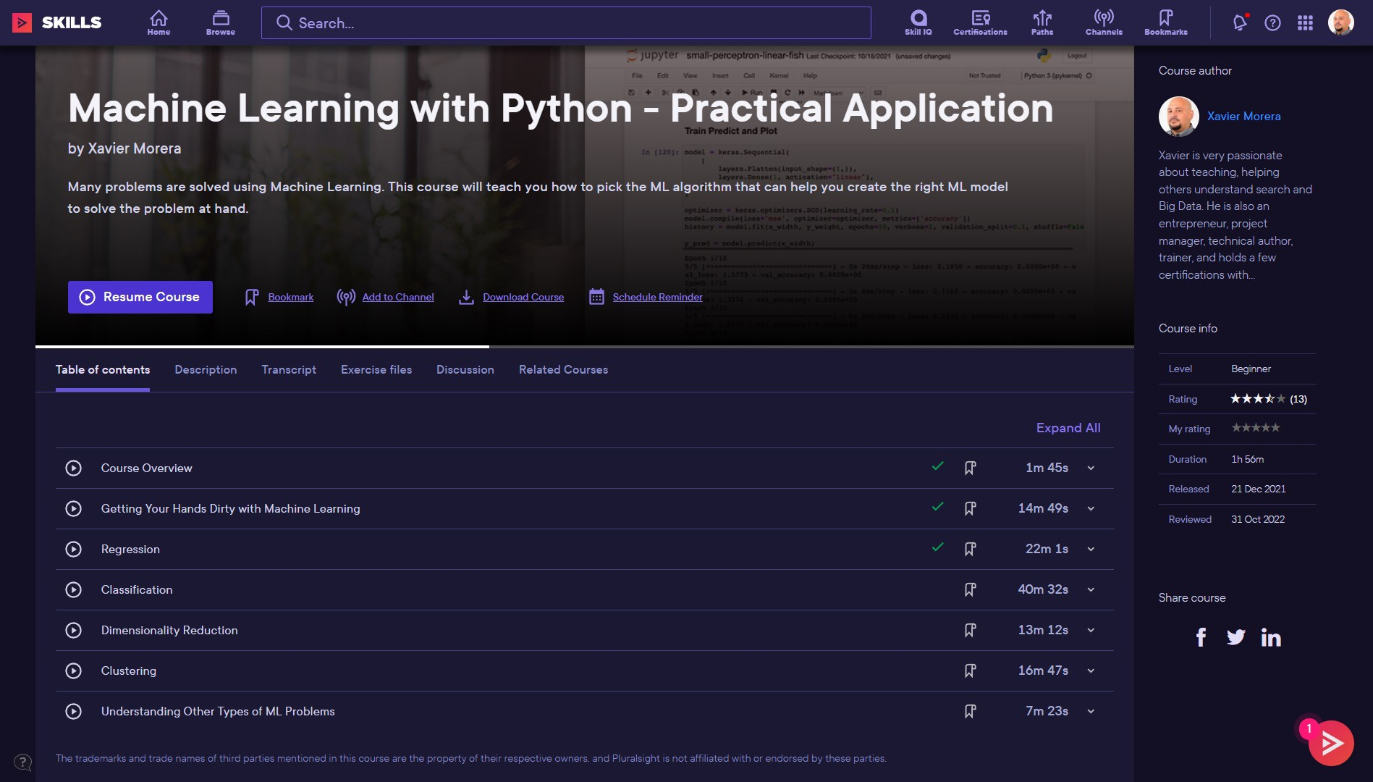

Slide 21
Classification Uses
Sentiment analysis
Spam detection
Image recognition
And more... This OpenAI API practical application deals with text

Slide 22
Classification

Slide 23
Sentiment Analysis

Slide 24
Sentiment Analysis
Technique used to determine and extract the emotional tone, opinion, or sentiment expressed in text data.

Slide 25
Sentiment Analysis
Involves analyzing a piece of text, such as a review, tweet, article, or comment.
Determine whether the expressed sentiment is positive, negative, neutral, or falls into more fine- grained categories like happiness, sadness, anger...

Slide 26





Applications of Sentiment Analysis
Social media
Product and service reviews Market research
Political analysis Brand management

Slide 27
Sentiment analysis

Slide 28
Named Entity Recognition

Slide 29
Named Entity Recognition
Technique that involves identifying and classifying specific named objects within a text, such as names of persons, organizations, locations, dates, and other specific types of information.

Slide 30
Named Entity Recognition
Primary purpose is to identify and classify named entities in the text.
Useful for many applications like information retrieval, document organization, chatbots...

Slide 31





Common Types of Entities
PERSON
Names of individuals, such as "Xavier Morera"
ORGANIZATION
Names of companies, institutions, or groups, like "Pluralsight"
LOCATION
Names of places, including countries, cities, and landmarks, such as "Costa Rica"
DATE
Expressions of dates and times, such as "February 24, 2024"
EVENT
Names of events or occurrences, like "Author Summit"

Slide 32
An Example of NER
Xavier Morera is a Pluralsight author. He has been creating courses since October 2013. He lives in Costa Rica.

Slide 33
An Example of NER
Xavier Morera is a Pluralsight author. He has been creating courses since October 2013. He lives in Costa Rica.

Slide 34
Named entity recognition

Slide 35
Keyword Extraction

Slide 36
Keyword Extraction
Technique used for identifying the most important and relevant phrases in a text.

Slide 37
Keyword Extraction
Extract keywords from documents, articles, a conversation, or any other textual context.
Particularly useful for content organization, search engine optimization, and topic analysis.

Slide 38
Example of Keyword Extraction
A few years ago everyone was talking about Big Data. Then the "Cloud" came and revolutionized how we work.

Slide 39
Example of Keyword Extraction
A few years ago everyone was talking about Big Data. Then the "Cloud" came and revolutionized how we work.

Slide 40
Keyword extraction

Slide 41
Language Translation

Slide 42
Language Translation
Process of converting written or spoken text from one language into another while preserving the meaning and intent of the original content.

Slide 43
Language Translation
Critical communication tool that allows people who speak different languages to understand each other's ideas, information, and messages.

Slide 44
The quick brown fox jumps over the lazy dog

Slide 45
The quick brown fox jumps over the lazy dog
The quick brown fox jumps over the lazy dog

Slide 46
The quick brown fox jumps over the lazy dog
El rápido marrón zorro salta sobre el perezoso perro

Slide 47
The quick brown fox jumps over the lazy dog
El rápido zorro marrón salta sobre el perro perezoso

Slide 48
Language translation

Slide 49
Text Parsing

Slide 50
Text Parsing
Technique for analyzing a sentence to identify its grammatical components such as nouns, verbs...

Slide 51
Text Parsing
Useful for linguistic analysis and information extraction.

Slide 52
Text Parsing
Xavier Morera is currently working as fast as he can to create this course, because he is very close to the deadline.

Slide 53
Text Parsing
Subject: Xavier Morera, he Verb: is working, is Adverb: currently
Prepositional phrase: as fast as he can Infinitive phrase: to create this course Conjunction: because
Adverb: very Adjective: close
Prepositional phrase: to the deadline

Slide 54
Text parsing

Slide 55
Paraphrasing

Slide 56
Paraphrasing
Technique used to rephrase a piece of text using different words while retaining its meaning.

Slide 57
Paraphrasing
Useful for content creation, avoiding plagiarism, and improving readability.

Slide 58
Original Phrase
Xavier Morera is currently working as fast as he can to create this course, because he is very close to the deadline.

Slide 59
Paraphrased
Xavier Morera is putting in maximum effort to develop this course promptly, as the deadline is rapidly approaching.

Slide 60
Other Possibilites
Xavier Morera is currently sprinting like a cheetah on roller skates to whip up this course, because the deadline is breathing down his neck like a hungry T-Rex.

Slide 61
Paraphrasing

Slide 62
Real World Applications

Slide 63

OpenAI
Research v
API v
ChatGPT v
Safety
Company v
Search log in JI I Try ChatGPT JI I
Blog
--G-_PT i3 p owers th.e.next:
..g:_eti:e.rat• i:• orr.c>.• f■ :_app.s-
Over 300 applications are delivering1GPT-3-powered search, conversation, text completion, and other advanced Al features through our APL.
Illustration: Ruby Chen

